Slide 1
Extreme Durable MDF The next generation of panel products with a 60 year service life for exterior and interior wet applications Presented by MEDITE SMARTPLY
Notes:
Good morning/afternoon
In 2009, after 80 years of research and development in the science of wood modification, an agreement was made between a technology company and an engineered wood panel manufacturer, to realise the commercial opportunities for an Extreme Durable Fibreboard
This new innovative and unique product is set to make the construction industry think differently about specifying wood and wood panel products in the future.
Introduce yourself and thank them for coming

Slide 2
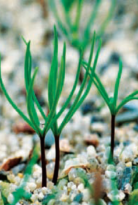
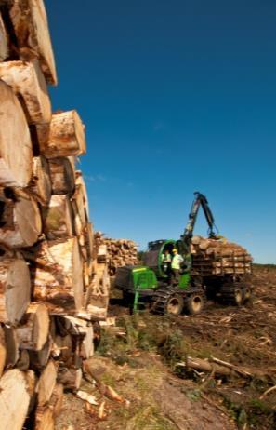
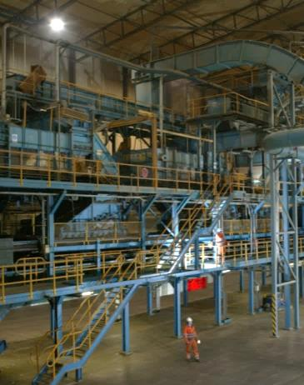
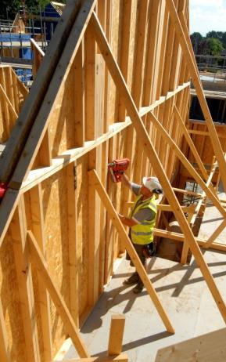
Who we are
MEDITE SMARTPLY is part of the Coillte Group, an Irish state owned commercial company.
Operating in forestry, land based businesses, renewable energy and panel products manufacture.
Coillte owns over 442,000 hectares of FSC certified forest.
Notes:
So, who are we?
Medite SmartPly are part of Coillte, an Irish state owned commercial company. Operating in forestry, land based businesses, renewable energy and manufacturing of wood based panel products.
Coillte own over 442,000 hectares of FSC certified forest which is approximately 7% of the land mass of Ireland.

Slide 3
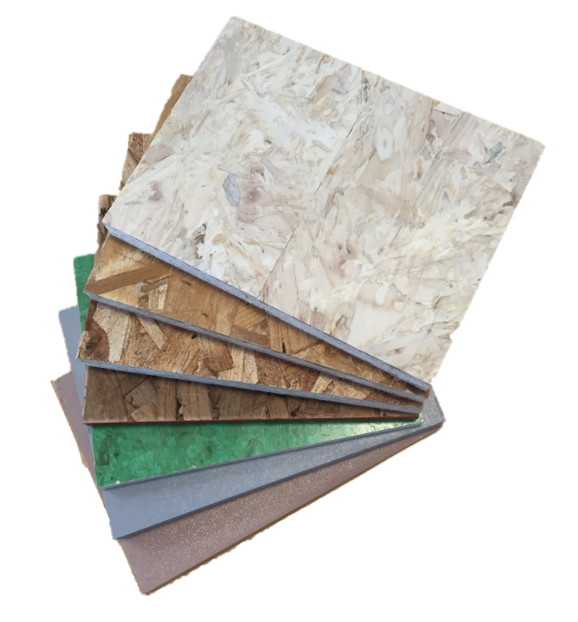
Who we are
Manufacturers of SMARTPLY OSB, a general purpose board for both structural and non-structural applications.
SMARTPLY OSB2
SMARTPLY OSB3
SMARTPLY OSB4
SMARTPLY PROPASSIV (OSB3)
SMARTPLY DRYBACKER (OSB3)
SMARTPLY SITEPROTECT (OSB3)
SMARTPLY TOUGHPLY (OSB3)
SMARTPLY FLAME RETARDENT (OSB3)
Notes:
Some of you might already be aware of our extensive OSB range, OSB is an acronym for Oriented Strand Board and it is an engineered wood based panel
We manufacture SmartPly OSB in Waterford for both general purpose use and the more specified technical applications in both structural and non-structural functions.
All SmartPly products conform to one of the lowest levels for formaldehyde release E1 and all our OSB3 panels are manufactured with a no added formaldehyde resin technology.
The list of our products you can see here on the screen.

Slide 4
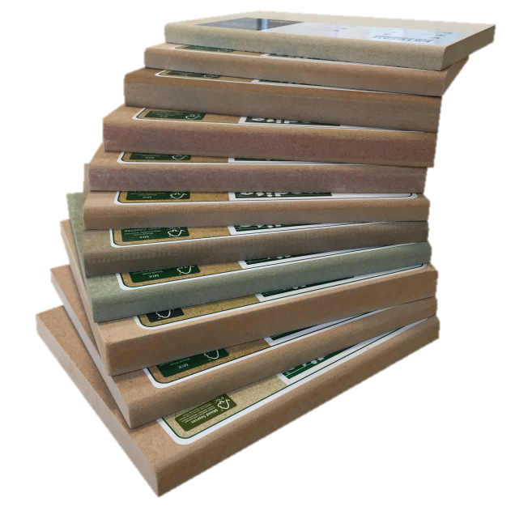
Who we are
Manufacturers of MEDITE MDF, a consistent high quality product with a range of variants.
MEDITE TRADE
MEDITE PREMIER
MEDITE MR
MEDITE ULTRALITE
MEDITE ECOLOGIQUE
MEDITE PREMIER FR B & C
MEDITE ECOLOGIQUE FR B
MEDITE EXTERIOR
MEDITE VENT
MEDITE TRICOYA EXTREME
Notes:
But we are here today to talk about Extreme Durable MDF. Some of you might already be aware of our extensive MDF range, Medite.
For anyone in the room who isn’t aware, MDF is an acronym for Medium Density Fibreboard.
Our manufacturing plant is in Clonmel, County Tipperary, Ireland where we produce a wide range of panels, many of which are an innovative 1st in the industry.
Here is a list including Medite Tricoya Extreme which is the only Extreme Durable MDF currently available in the market.

Slide 5
Learning Aims
What is wood modification via acetylation method?
What is Extreme Durable MDF?
What tests have been done on Extreme Durable MDF?
What are Extreme Durable MDF’s leading uses?
Q&A
Notes:
So what are the learning aims we will cover today? we will go through these 4 topics
What is wood modification by acetylation method?
What is Extreme Durable MDF?
What tests have been done to prove its performance?
What are the leading uses that have been identified, to date?
And we will have plenty of time at the end for any questions.

Slide 6
What is wood modification via acetylation method?

Slide 7
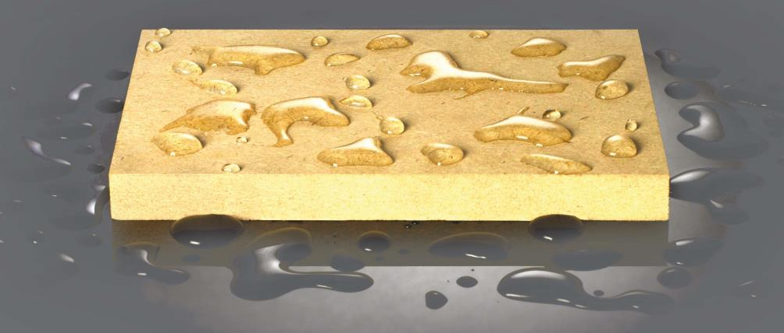
Wood Modification
In this section we will cover the following topics:
Description of acetylation
What is the acetylation process
Notes:
So, What is wood modification by acetylation method?
Has anybody in this room seen a presentation on a product called Accoya? A raise of hands if you have.
If yes, then you will have the slight advantage over the rest of the room, when we get to the technical bit.
In this section we will cover a description of what acetylation is, the process by which the wood is modified and then turned in to an Extreme Durable MDF.

Slide 8
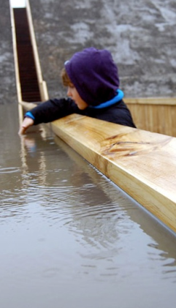
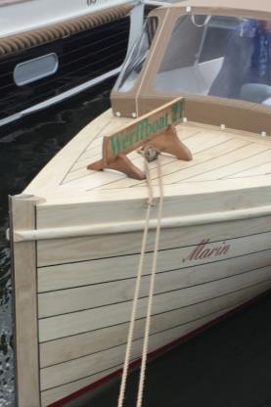
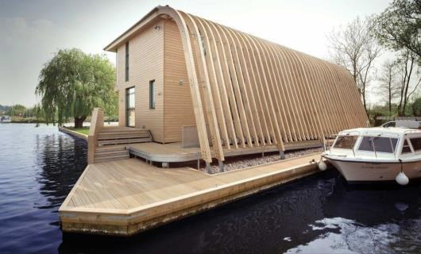
Wood Modification
Tricoya Technologies (TTL) own the proprietary technology to make acetylated wood elements (Tricoya), from which Extreme Durable MDF is manufactured.
TTL is part of Accsys, the owners of Accoya wood.
Ideal for exterior applications such as; windows, doors, cladding, decking and bridges
Notes:
Tricoya Technologies (TTL) own the intellectual property behind the proprietary production technology to make acetylated wood elements (Tricoya), from which Extreme Durable MDF is manufactured
TTL is part of a group which includes Accsys Technologies, who own the proprietary technology behind the solid wood version (Accoya), which was first launched in 2007.
Acetylated wood, is derived from a fast growing non durable wood species, but once modified is a durable, dimensionally stable, sustainable product.
Ideal for exterior applications such as; windows, doors, cladding, decking and even bridges, as shown in these images.
Anyone who has been to an Accoya CPD might already be aware of these projects.

Slide 9
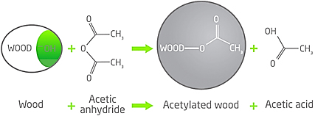
Wood Modification
Description Acetylation
Acetylation changes the free hydroxyls within the wood into stable and moisture resistant Acetyl groups.
This is done by reacting the wood with acetic anhydride, which derived from Acetic Acid (vinegar)
Notes:
So, here's the technical bit.
Fast growing, non durable, plantation softwood species such as Pine and Spruce contain a large proportion of what is known as Hydroxyl groups within the cell walls of the wood.
It is these Hydroxyls which suck up moisture like a sponge when subjected to the elements, causing the wood to expand and contract.
This moisture is also a great home to fungus and other rotting enzymes, hence the reason why softwoods do not last long unless you treat them with a chemical, which only extends the life by a few extra years.
Within the cells of the wood there are also a small number of acetyl groups and these reject moisture which prolongs the life of the wood.
Slow growing hardwood species contain larger number of acetyls, which is why they tend to last longer. The problem of course with hardwood species, is they take too long to reach maturity and tend not to be very environmentally sustainable.
**FOOTNOTE**
Acetic anhydride shares a similar chemical make up to acetyls

Slide 10
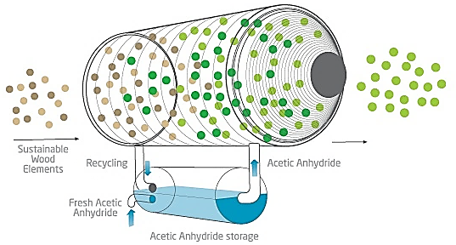
Wood Modification
Description Acetylation
Acetylation dramatically improves the fibreboards durability, stability, coatings performance and service life
Notes:
Acetylation, effectively converts the hydroxyl groups into stable and highly moisture resistant acetyl groups.
This is done by reacting the wood with a chemical called acetic anhydride, which is derived from acetic acid, which is vinegar to you and me.
Hence the slight smell you can get from the samples, this acetylation process is a permanent chemical conversion of the hydroxyls into acetyls.

Slide 11
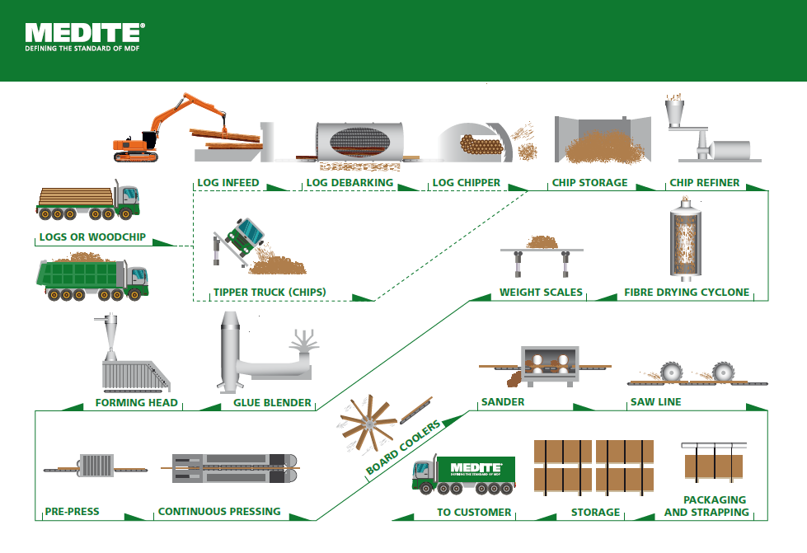
Wood Modification
The MDF Process
Notes:
This slide shows a typical flow diagram of how MDF is traditionally made and where we add the magic to transform the wood chip in to the Tricoya element before turning it in to the Extreme Durable MDF.
Medite has built its business on innovation, being the first manufacturer to make the original generation of Exterior MDF which is still used today, along with a raft of other “firsts” in the MDF world, like FR MDF and zero added formaldehyde MDF.

Slide 12
What is Extreme Durable MDF?

Slide 13
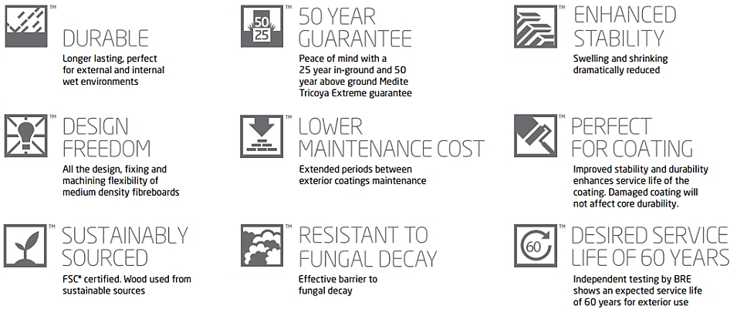
What is Extreme Durable MDF?
Performance benefits
Notes:
Extreme Durable MDF has all of the attributes associated with “normal MDF” like design freedom, great cutting, routing and machining capability. Manufactured from sustainably sourced timber and being perfect for coatings and then some..!
The difference, however, is in the long term performance.
Due to the modification process of the raw material, the resultant panel has exceptional dimensional stability and thickness swell performance, it is extremely durable and is resistant to fungal decay.
These attributes serve to extend the life of coatings applied to the board and therefore reducing the maintenance costs.
An extensive amount of independent testing carried out on the product has demonstrated that it has a service life expectation of at least 60 years and this led us to apply a performance warranty of up to 50 years on the raw panel itself.
This is a 50 year guarantee in Use Class 1, 2 & 3 and a 25 year guarantee in a Use Class 4 environments which is direct and permanent contact with or in close proximity to soil and water.
***FOOTNOTE***
Definition of Use Classes (EN335 Durability of wood and wood based panels)

Slide 14
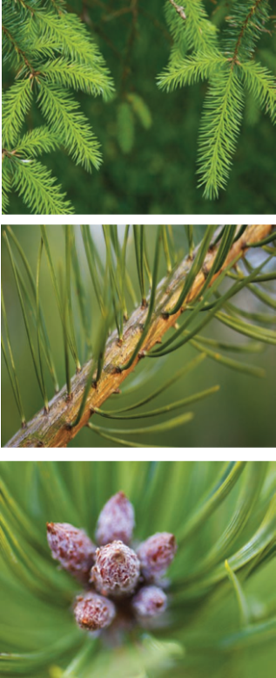
What is Extreme Durable MDF?
Performance benefits
50 year guarantee on the substrate
Non-toxic acetylation process
Formaldehyde free resin system
Helps towards BREEAM and LEED credits
Meets CARB2 emission limits
Non hazardous material – can be recycled
FSC® certified
Notes:
The benefits of an Extreme Durbable MDF is a high performance panel which is manufactured using a formaldehyde free resin system offering up to a 50 year guarantee on the substrate.
Therefore helping toward LEED and BREEAM accreditation as it exceeds CARB2 compliance for formaldehyde emission.
No tropical hardwoods are used in the manufacturing process, only wood sourced from FSC certified sources.
And as the process of acetylation is non toxic, non-hazardous and therefore Extreme Durable MDF can be recycled.

Slide 15
What tests have been done on Extreme Durable MDF?

Slide 16
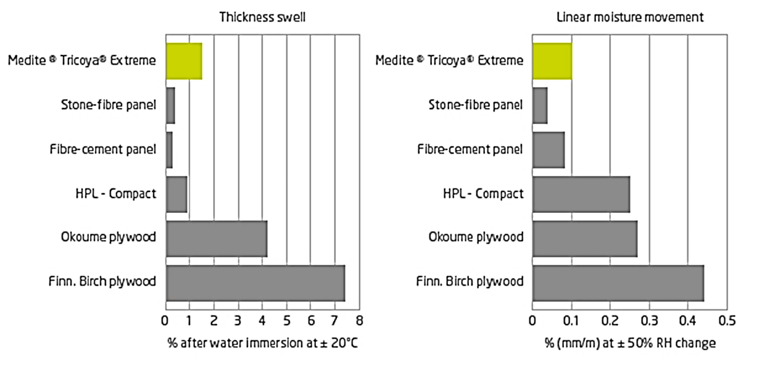
Tests on Extreme Durable MDF?
Stability test
% after water immersion at +/- 20°C – 72 Hours
% (mm/m) after water immersion for 48 hours
Notes:
We now move to the tests that have been carried out to demonstrate its performance.
These tests were co-ordinated by the BRE (British Research Establishment) which is an independent test facility.
This slide shows the results of a comparative test carried out showing the extreme performance of the product when compared to both wood and more importnantly non-wood based products in the market place.
The first table on the left shows the thickness swell performance, when soaked for a period of 72 hours and then allowed to dry.
You can see that the Extreme Durable MDF outperforms against the best plywood’s on the market today and performs similar to the non wood alternatives available.
Some people imagine that a compact laminate, for example, would not swell but in fact it does, as do the stone fibre and fibre cement products as they are not inert.
The table on the right demonstrates the products exceptional dimensional stability performance which is how it moves in both the length and width when soaked for a period of 48 hours.
Here you can see it performs similar to and, in some cases, better than the competing products.

Slide 17
Tests on Extreme Durable MDF?
Accelerated exterior weathering test
Freeze/thaw cycles:
3 hours water soak at 20ºC
3 hours freezing at -20ºC
Wet/Dry cycles:
18 hours storage in water >5ºC
6 hours storage at 60ºC/20%RH
Result - No cracks or delamination Significantly improved dimensional stability performance in all dimensions through cycles.
X 25
Notes:
To further test the long term durability of the product, samples were independently tested to an accelerated durability test.
As you see from this slide it was quite severe. The samples were subjected to
3 hours soaking at 20 degrees C
3 hours freezing at -20 degrees C
18 hours storage in water at below 5 degrees C
and 6 hours storage at 60 degrees C with a 20% relative humidity
******Press for animation X25***********
As if this was not punishing enough the test was repeated continuously 25 times!!
******Press for final bullet point***********
Extreme durable MDF made some impressive result with no cracks or delamination and had significantly improved dimensional stability performance in all dimensions through the 25 cycles.

Slide 18
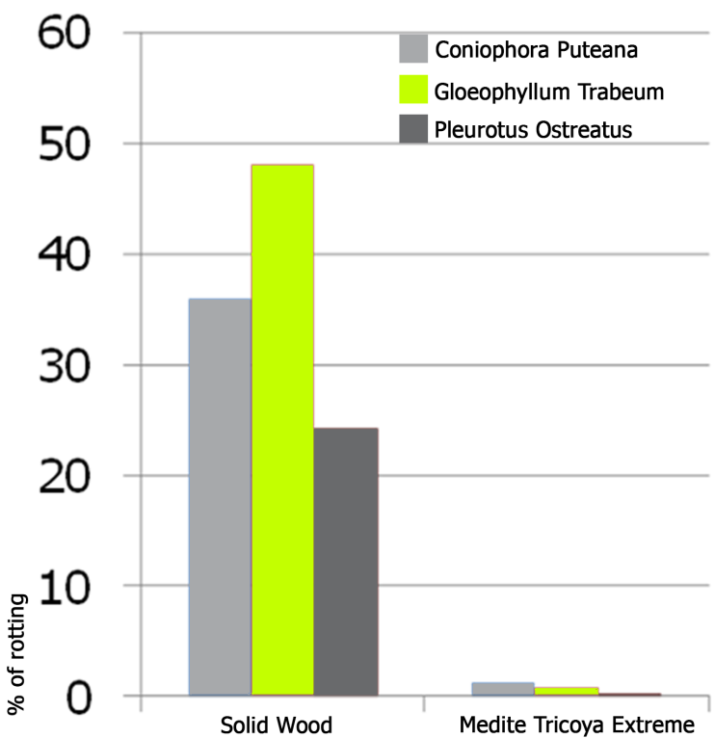
Tests on Extreme Durable MDF?
Durability assessment EN350-1
“Extreme Durable MDF is fully resistant to decay by basidiomycetes fungi’ and achieves a 60 year service life, in accordance with BS8417 exterior use”
Notes:
Samples of Extreme Durable MDF were subjected to a durability assessment under the European standard EN350-1.
This is where the samples were exposed to brown and white rot, shown on this table by their botanical names.
You can see how little weight loss the samples suffered when compared to solid un-modified wood.
The BRE concluded that the product was fully resistant to decay by these fungi and would meet a 60 year service life expectancy in accordance with the British Standard BS 8417.
***FOTENOTE***
If asked BS 8417 is British Standard for Preservation of Wood. Code of Practice.
The Standard takes the form of guidance and recommendations to help determine the need for treatment and if so helps users specify the preservative treatment of wood.

Slide 19
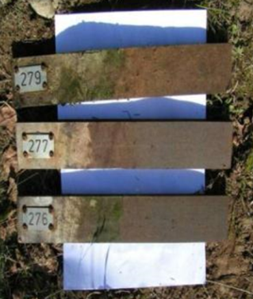
Tests on Extreme Durable MDF?
Durability assessment – EN311
Accelerated and aggressive in ground testing
Test running for 14 years
No deterioration or decay on acetylated MDF samples
Further supports BRE’s findings of class 1 durability
Equivalent to slow grown Teak and Aged Oak
Notes:
This slide shows the effects on some prototype panels manufactured using acetylated Aspen back in the 1990’s, that had been placed in the ground like pegs, alongside “normal” timber stakes.
After 14 years of the test, there is no notable deterioration or decay on the acetylated panels. The timber stakes on the other hand had completely deteriorated.
This was the first and still to date only wood based panel product to be given a durability classification. Therefore the durability of an Extreme Durable MDF can be compared to those of a similar durability like slow grown Teak and aged Oak which is a Durability Class 1.
**FOOTNOTE**
The trial is continuing and is checked on an annual basis, the untreated timber stakes had fully deteriorated after 6 years.

Slide 20
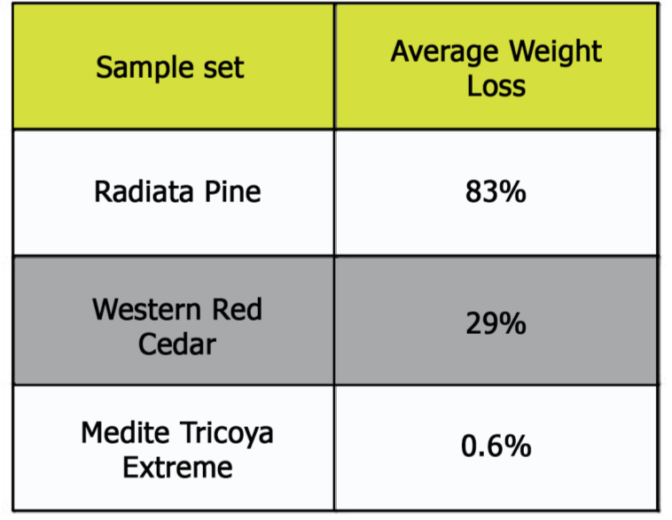
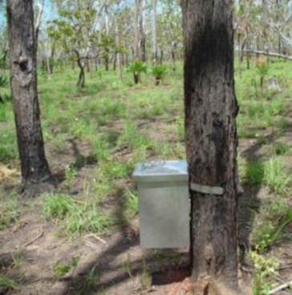
Tests on Extreme Durable MDF?
Termite testing
Notes:
To further demonstrate the suitability of Extreme Durable MDF in any environment, samples of the panel have been subjected to the most voracious of wood boring termites in the Northern Territories of Australia.
After 3 years, the results can be seen of the weight loss experienced by the comparison products.
Western Red Cedar, a relatively resistant timber species, still suffered 29% loss in it’s mass compared to less than 1% for the Extreme Durable MDF.

Slide 21
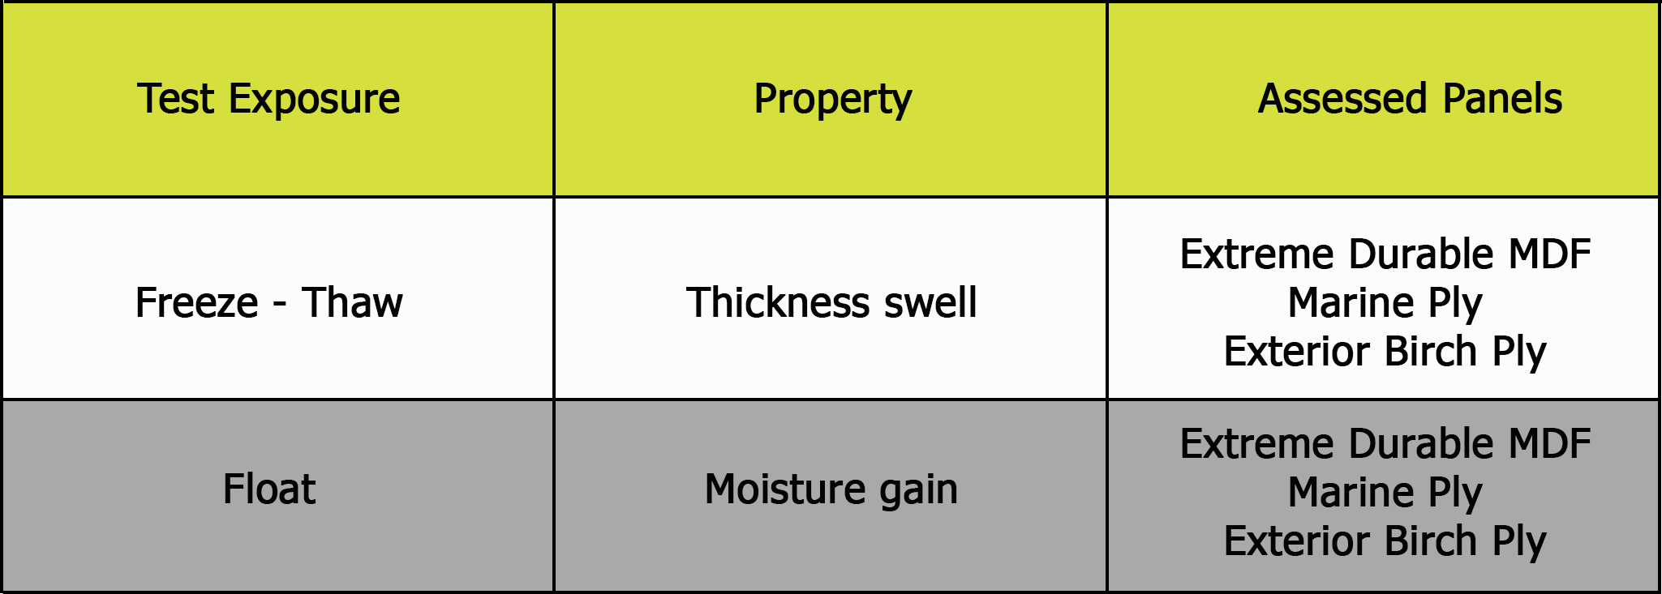
Tests on Extreme Durable MDF?
Exterior plywood accelerated lab test
Bowing
Notes:
Although Extreme Durable MDF is more suited as an alternative to non-wood based panel products, there would be a natural propensity to compare it to wood panels.
There are some high performance, cost effective plywood products that can provide a solution to some external envelopes.
But its wider use is often restricted by its performance characteristics such as long term durability, coating maintenance, stability, poor edge profiling and, in some cases, sustainability aspects.
We therefore instructed some comparative testing's to be done with the best plywood's on the market today.
A finish birch (hardwood) plywood and a full BS1088 Marine grade hardwood panel to compare on performance.
The two tests were:
A freeze/thaw test to look at the thickness swell and bowing comparisons.
And a float test to measure the moisture gain.

Slide 22
Tests on Extreme Durable MDF?
Freeze – Thaw test
Exterior plywood
Significant bow on all samples
Significant variation between samples
Extreme Durable MDF
Minimal bowing
Birch Plywood
Marine Plywood
Extreme Durable
MDF
Notes:
The top sample is 18mm Birch Plywood
The middle sample is 18mm Marine Plywood
The bottom sample is 18mm Extreme Durable MDF
As you can see from the samples on the screen there was significant and variable bowing measured on the plywood samples, whilst only minimal bow on the Extreme Durable MDF sample.
**FOOTNOTE**
Due to the construction of Plywood (peeled log to produce the veneers) it doesn’t have the guaranteed quality and consistency which can be achieved with an engineered wood product.

Slide 23
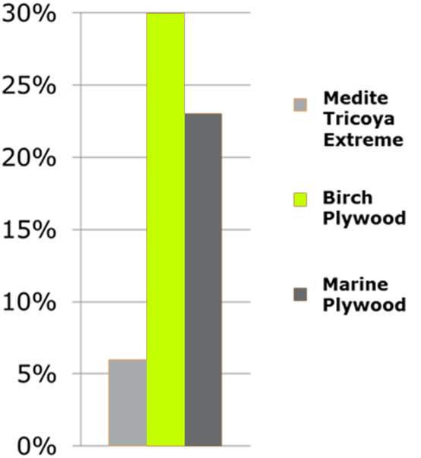
Tests on Extreme Durable MDF?
Float Test
Exposure adapted from EN927. Uncoated samples float on water bath for 72 hours.
Extreme Durable MDF performs 3 times better than marine grade plywood and birch exterior plywood
Notes:
The float test, measured the moisture gain on all three products.
Extreme Durable MDF is manufactured to a 3-4% moisture content and you see here that it barely moved above 6% moisture content.
Plywood on the other hand, starts off at between 8 to 12% moisture content and you can see from this table, that both products took on significant moisture, raising them to in excess of 20%.

Slide 24
Processing of Extreme Durable MDF
Fabricating
Can be cut, machined and used in exactly the same way as standard MDF.
Coating
Conventional water-based paint coatings may be used to decorate the panel.
Laminating
Melamine papers, high pressure laminates and foils can be adhered to the product.
Fixing
Due to some residual acetic acid, stainless steel fasteners and fixings must be used. A2 or A4
Gluing
Extreme Durable MDF can be bonded with a range of glues including PU, Epoxy, PRF and EPI.
Sanding
Can be sanded with fine sandpaper to achieve a smooth finish.
Notes:
As part of the on-going testing on Extreme Durable MDF. It is proving to be very suitable for different types of finishing:
Fabrication, Coating with various paints and stains, laminating with a variety of different finishes, including melamine impregnated paper, foils, vinyl's, metals, high pressure laminates to name but a few, bonding together, sanding etc.
The design freedom associated with the product will lead to a wide range of uses.

Slide 25
Coating performance warranties
A number of coating manufacturers have successfully trialled the acetylated wood fibreboard
Extended coating warranties on exterior joinery and cladding manufactured from Extreme Durable MDF and with a fully factory finished approved system.
Warranties up to 10-15 years respectively on opaque finishes
Other leading coating companies are working on their own testing and warranties
Notes:
Because of the products improved dimensional stability and thickness swell performance, a number of coating companies have tested their standard acrylic coatings on Extreme durable MDF and have produced extended warranties.
Following accelerated testing for UV and degradation for their products, they are comfortable that the coatings will last longer than those on normal wood substrates.
This further demonstrates the long term maintenance advantage of using Extreme Durable MDF.
**FOOTNOTE**
It is possible to use any acrylic or solvent based paints, however we recommend an acrylic based paint as they are more environmentally friendly.

Slide 26
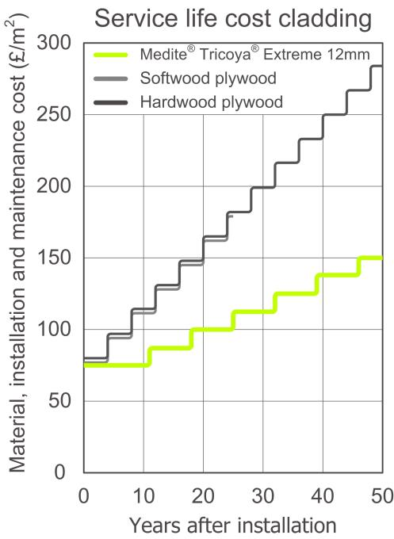
Service life cost
BM TRADA service life cost analysis, comparing softwood & hardwood plywood with MTE
Initial cost of coated MTE in line with coated exterior grade plywood
MTE has much lower cost during total service life due to long maintenance intervals
Financial advantage from a very early stage
No need for replacement or repair if maintenance is poor
Notes:
We recently commissioned TRADA to carry out a cost analysis on the service life benefits of Extreme Durable MDF versus some high performance plywood products.
One was a pre-primed high quality Birch hardwood plywood and the other was a pre primed Douglas Fir Plywood.
The material cost of the two plywood's was similar to the Extreme Durable MDF (12mm) and the installation cost was the same.
Due to the plywood requiring more frequent maintenance, the long term cost saving soon becomes apparent.
As demonstrated in this slide and because of Extreme Durable MDF’s much improved dimensional stability performance, by substituting a thinner panel this results in a quicker pay back.
Note in case question is asked: Why 12mm? Due to the enhanced dimensional stability performance, 12mm can be substituted for equivalent 18mm plywood panel without a loss of performance.

Slide 27
Advantages & Disadvantages
Advantages
Lower maintenance cost
Excellent machining capabilities
Lightweight compared to non wood alternatives
FSC certified
60 year service life
Coating performance extended
50 year manufacturer guarantee
Disadvantages
High grade stainless steel fixings required
Adhesive curing times extended
More fixings needed for facades
Notes:
We have tried to be impartial when looking at the products attributes and you would even be forgiven for thinking that it is perfect for everything.
Here we can see the advantages of using and Extreme Durable MDF panel
Excellent machining capabilities
Extended coatings performance
Lower maintenance costs
Lighter in weight to all the non wood products
Environmentally sustainable and long lasting
And the disadvantages, which are only a few
Due to the small trace of residual acetic acid, we recommend only to use stainless steel high quality fixings, which can be costly. In an exterior façade however, stainless steel fixings tend to be recommended anyway to reduce the incidence of staining.
Due to the dryness of the panel, curing times and rates for bonding to or bonding together can be extended
Compared to compact laminates and fibre/rock cement panels, the product will require an increased number of fixings, particularly in higher rise buildings.

Slide 28
Independent Industry Bodies
‘An exterior joinery product (such as a cladding panel) prepared from Extreme Durable MDF, is likely to show significantly improved coating performance properties. If the cladding is designed and built to the principles of best practice (to minimise moisture ingress and maximise water shedding), factory finished using quality coatings it will provide exterior joinery of outstanding durability and dimensional stability that would be likely to meet a 60 year service life requirement.’
Dr Ed Suttie MIWSc
Director, BRE Timber
Notes:
In conclusion, with regards to the testing carried out on our product, the Director of Timber at the BRE, who coordinated all of our product testing, concluded the following statement:
An exterior joinery product such as a cladding panel prepared from Extreme Durable MDF, is likely to show significantly improved coating performance properties.
If the cladding is designed and built to the principles of best practice and factory finished using quality coatings.
It will provide exterior joinery of outstanding durability and dimensional stability that would be likely to meet a 60 year service life requirement.
Quite a testament, from one of the key and most knowledgeable men within the timber industry and what he doesn’t know about modified wood quite frankly isn't worth knowing.

Slide 29
Indicative cost comparison - Cladding
Material | Cost | Width | Labour cost for fixing | Batten/ support system | Surface finish | Re - coat costs | Service life | Initial cost (inc. support system) | 60 year lifetime cost (inc. support system)
Extreme Durable Fibreboard | £40 - 50m² | Up to 2240mm | Easy £10-15/m² | £10/m² | Included | £10/m² | 60 years 10 years recoat | £60 - 75m² | £120 - 135/m²
Compact Laminate | £55 - £75/m² | Up to 1860mm | Difficult £25-35/m² | £25/m² | Included | £10/m² | 30 years 15 years recoat | £105 - £120/m² | £240 - 270/m²
Fibre Cement | £35-£45/m² | Up to 200mm | Difficult £20-30/m² | £15/m² | Included | £10/m² | 60 years 10 years recoat | £70 - £85/m² | £120 - 135/m²
Timber | £15 - £50/m² | Up to 225mm | Easy £10-15/m² | £10/m² | Not included £10- 20/m² | £10/m² | 30 years 3 -5 years recoat | £45 - 85/m² | £210 - £290/m²
High Density Wood Composite | £35 - £45/m² | Up to 296mm | Moderate £20-25/m² | £10/m² | Included | £10/m² | 30 year 10 years recoat | £65 - 80/m² | £180 - 210/m²
Acetylated Timber | £45 - £50/m² | Up to 195mm | Easy £10-15/m² | £10/m² | Not included £10- 20/m² | £10/m² | 60 years 10 years recoat | £75 - £85m² | £125 - £135/m²
Notes:
Extreme Durable MDF may have a higher initial cost than most of the competing products, however, if you take in to account the lower installation cost, combined with no support system always being needed, the serviceable lifespan and the lower cost of maintenance
**********click for red box to appear**********
The actual lifetime cost of the product is lower than all competing products.

Slide 30
What are Extreme Durable MDF’s leading uses?

Slide 31
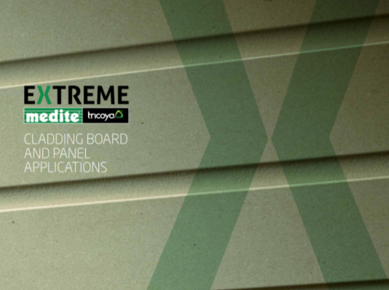
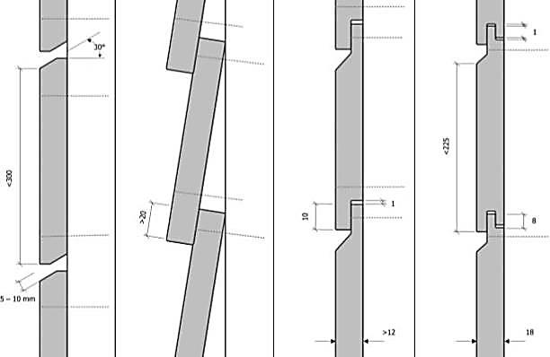
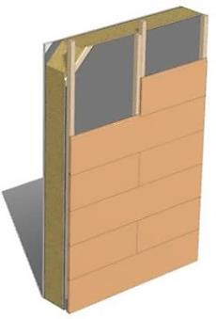
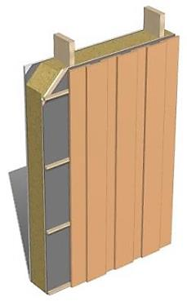
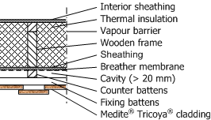
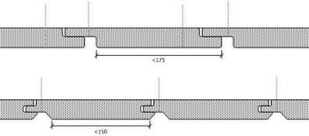
Cladding Detail
Notes:
One area that we see great opportunity for this versatile material is in the cladding and façade sector.
We have produced a brochure, showing the various ways and ease at which the product can be used in this sector.
We have also worked with a number of industrial processing companies that are now producing their own range of finished and semi finished cladding, façade and roofline solutions.
If you would like to gain a copy of this cladding document, come see me after the presentation.

Slide 32
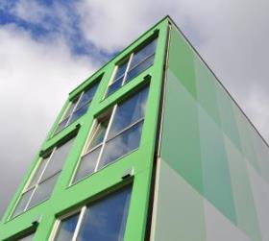
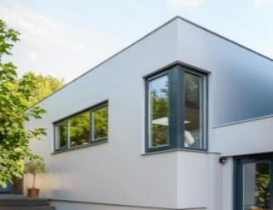
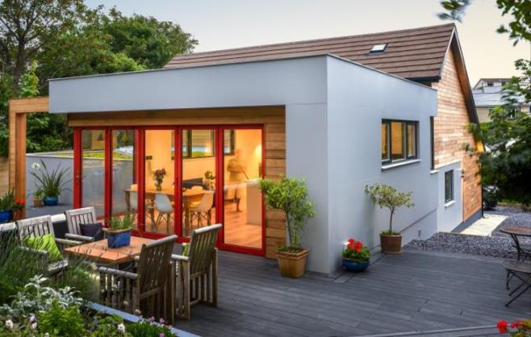
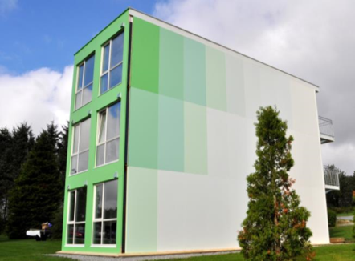
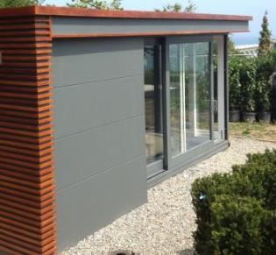
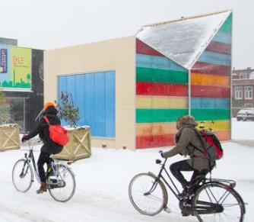
Applications - Facades
Notes:
Here are 4 examples of the products use in a façade/cladding application.
The two grey panel images, are the result of a bungalow conversion near the beach in Newquay Cornwall.
The client was determined not to use a cement panel and had to convince the architect that this product would meet the durability and aesthetic criteria and benefit from being environmentally sustainable.
It was much easier to cut and coat to the required colour and was easier to install.
***FOOTNOTE***
In case you are asked:
The green images are container conversions from Norway, designed by students as challenge to find a student accommodation issue. It includes Accoya in the construction as well as Medite Tricoya Extreme and were pre painted offsite. They have been installed in a way that allows for the removal and relocation of the containers.
The Grey “Garden Building” is in Dublin Ireland and also includes Accoya for the timber cladding.
The multi coloured image in the corner, is the result of a design competition in The Netherlands, combining Medite Tricoya Extreme and coloured semi transparent panels.

Slide 33
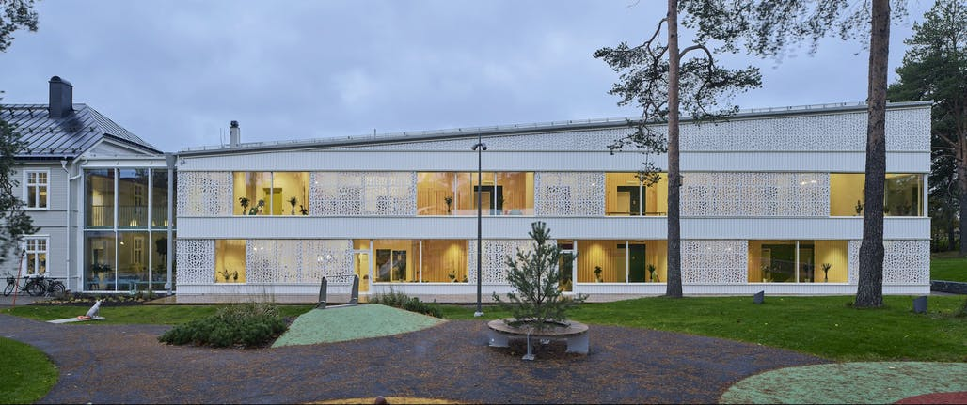
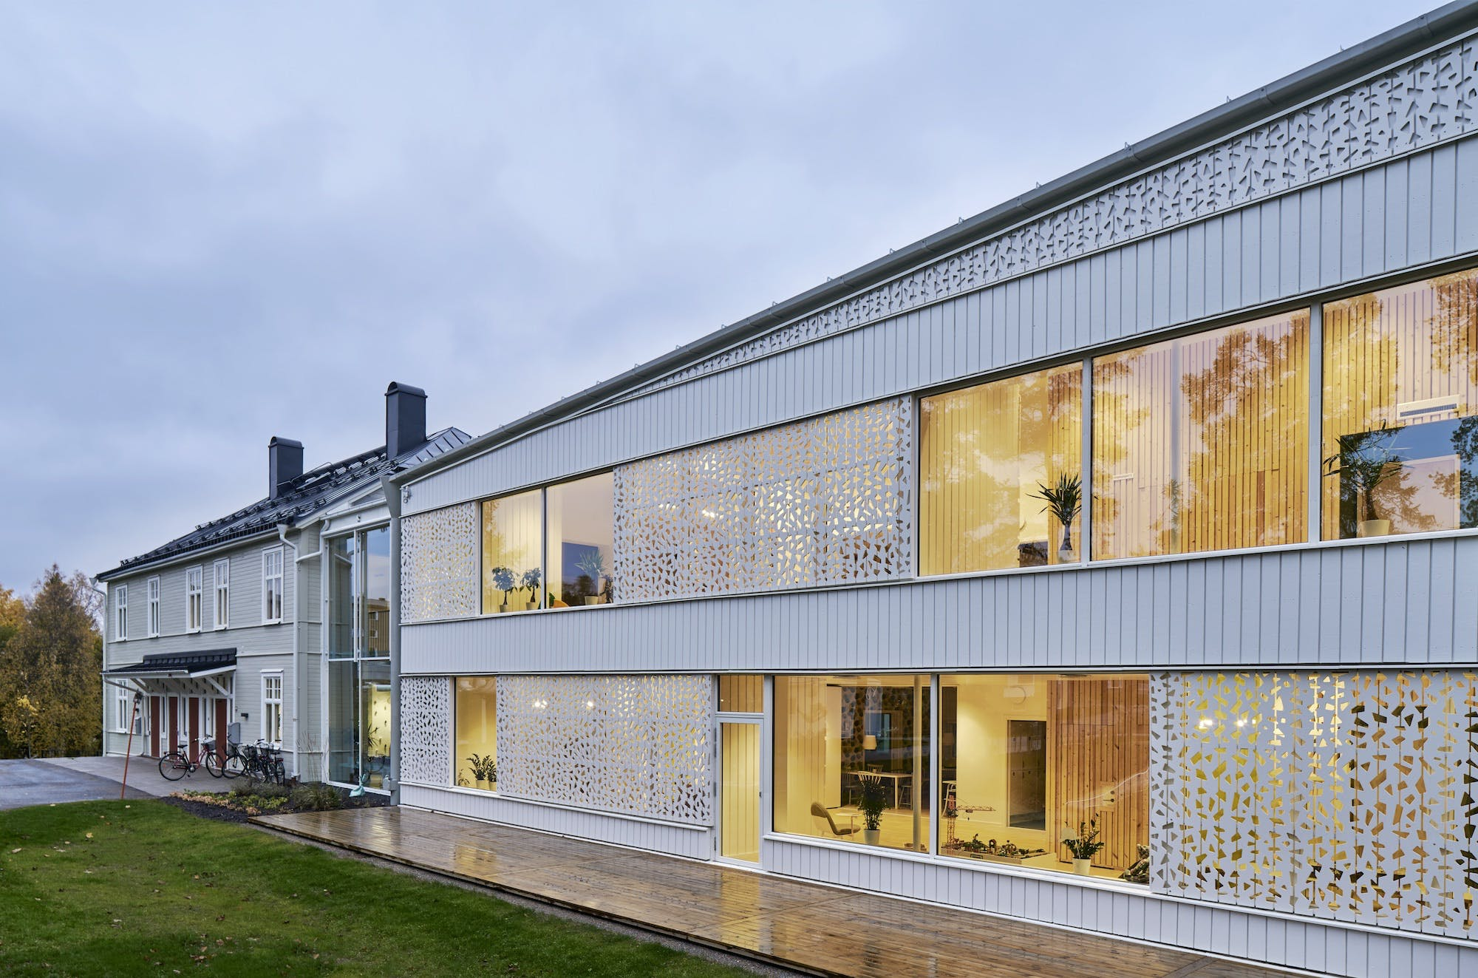
Cladding & Brise Soliel – Children's Hospice, Sweden
Original specification called for timber
Required 25 year core material guarantee
Vertical cladding panels in sheet form – less joints
Panel for Brise Soliel machining provided less waste
Lightweight
Panels easily cut to size
Guaranteed paint system
FSC Certification
Notes:
This project came to our attention in 2015, when the architect had approached our distributor, asking for a solution for a cladding and Brise Soliel, for the building extension in Sweden.
They wanted a solution that could be mobile (slide along the glass wall) on this Children's Hospice. The orginal specification called for a timber solution, but MTX with it’s ability to be machined in panel form and to be able to have the intricate design, was chosen.
They also wanted a substrate that had a 25 year guarantee. MTX would give them 50 years, so no problems there.
The paint warranty for this project is set at 15 years, using a PPG paint system, and re-decoration will be simple as, unlike traditional wood, the panels can be removed, given a light rub down to give a key, then be re-sprayed.
Installation early 2018.

Slide 34
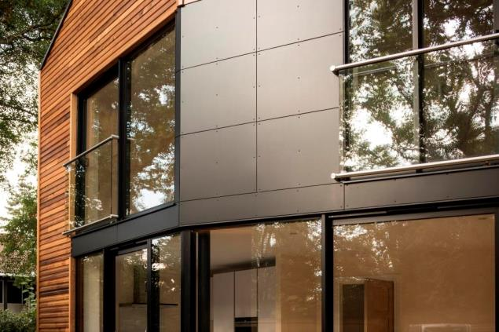
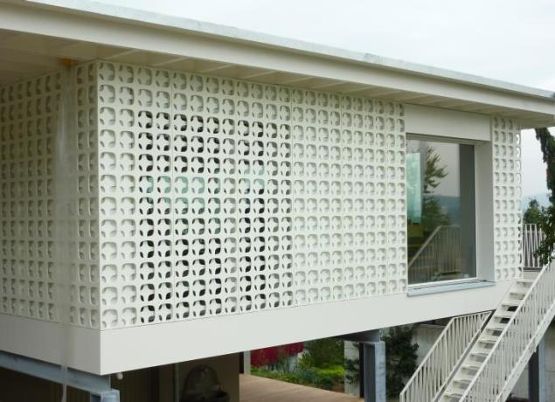
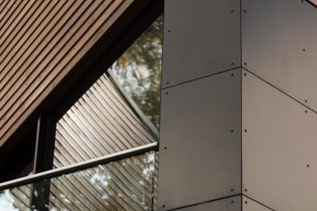
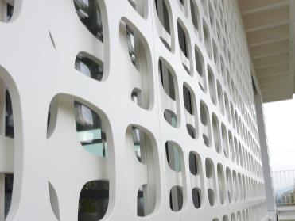
Applications - Facades
Notes:
These images, the brown on the left from Bagshot in Surrey and the white on the right from Switzerland, demonstrates the design possibilities of combining the durability of the modified element, with the machining technology available from a Medium Density Fibreboard.
The brown painted panels are on a new development, where the architect wanted to mix traditional timber with flat panels.
The White panels were only possible because the architect/designer had a truly durable exterior fibreboard panel to work with.
These designs can be created using normal wood panel machines and a durable acrylic coating systems.

Slide 35
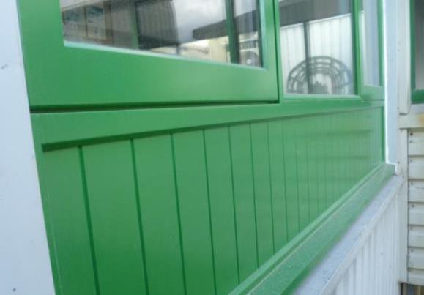
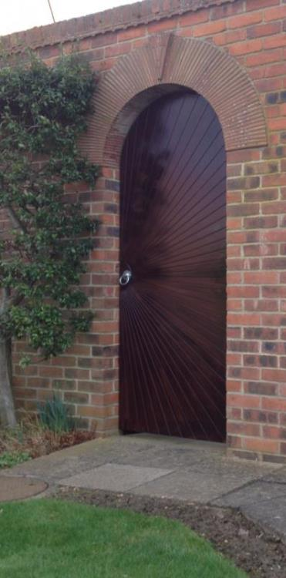
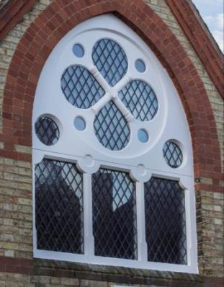
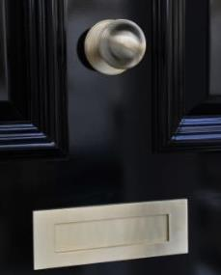
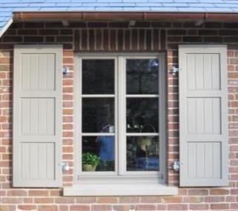
Applications – Doors & Windows
Notes:
Top left – Wales - infill panels machined to look like individual timber strips – less joints, little movement, longer lasting coating
Middle Door – Scotland - Accoya frame with a “sunburst” stained Medite Tricoya Extreme overlay panel.
Top right – Cambridgeshire – church conversion window, incorporating Accoya & Medite Tricoya Extreme.
Bottom, second from left – Germany – window shutters. Previously manufactured from timber. Now less likely to rot, longer lasting and more stable

Slide 36
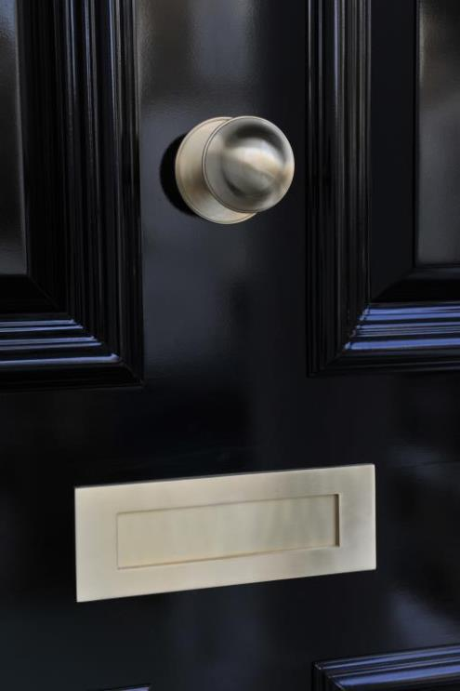
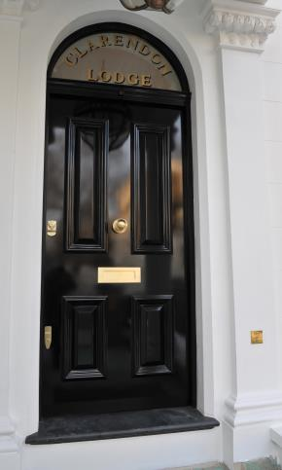
AMS Joinery
“Front door panels of this size can have issues including splitting and the necessary subsequent repair, and we were looking for an alternative which would enable us to create a perfect and durable product first time.”
Notes:
AMS Joinery of Maidstone, Kent worked on a Victorian town house in Notting Hill, London which had been undergoing a full refurbishment to bring the property back to its former glory.
The owner had specific designs in mind intended to retain as much of the property’s period feel as possible. One of AMS Joinery’s tasks was to manufacture and install a large No. 10 Downing Street style front door to the newly renovated property.
The reasons Medite Tricoya Extreme was selected were
It has little movement
It easily handles wet environments with minimal change
It machined cleanly to an impressively high standard
The chosen finish for the door was a black gloss polyester spray, which gave it a smooth gloss finish with no brush marks.

Slide 37
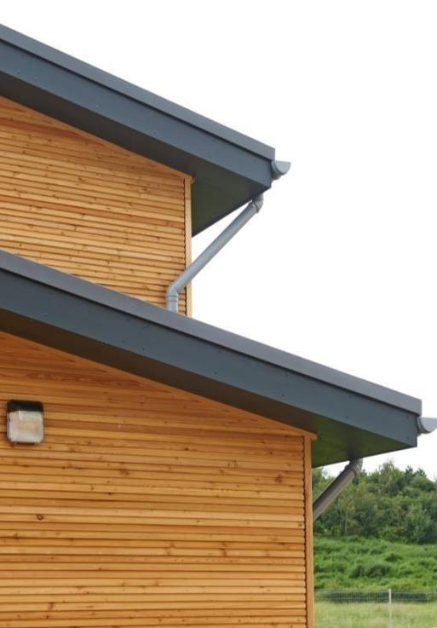
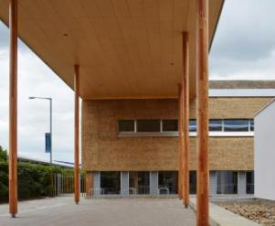
Applications – Fascia's and Soffits
Notes:
University East Anglica
Designed by architects Architype, BDP Engineers and Churchman Landscape Architects, The Enterprise Centre is the UK’s first commercial building to achieve both Passivhaus and BREEAM Outstanding standards.
For a new covered walkway(pictured above) over 600m2 of Medite Tricoya Extreme was specified. The durable, acetylated wood panel helped maintain the integrity of the structure whilst also ensuring it remains aesthetically pleasing. Additionally, the product requires low maintenance so reduces both cost and disruption during its life cycle.
Applied to the walkway’s external face, the panels were finished with Osmo natural oil coating to deliver water and dirt resistance, moisture regulation, reduced wood swelling and shrinkage, and a maintenance free solution for more than 10 years.
Periscope House – As featured on Grand Designs the popular Channel 4 programme fronted by Kevin McCloud designed by Studio Bark, using Medite Tricoya Extreme for the fascia boards

Slide 38
Two projects Netherlands
Original spec, gaboon marine plywood and compact laminate.
Switched to Extreme Durable MDF
Better machining
Better paint finish
Extended paint performance
Core guarantee
FSC certified
Light in weight than compact
More stable
Notes:
Here we see 2 examples of the products growing acceptance for use in roofline applications.
Extreme Durable MDF was chosen over both marine grade plywood and compact laminate on these two projects in The Netherlands.
The ability to machine easily, the improved and extended performance of the coating, the core guarantee, the lightweight nature and the FSC certification all served to convince the client of the products suitability.
A large number of projects have since been completed both here and on the continent.

Slide 39
Applications – Outside furniture
Notes:
Sea front benches, Brighton Council Roof Top landscape garden project, Ludgate, London
Design project, German Students Table top finished with a metal liquid coating in Ascot, Berkshire
Quirky bug encouraging bench, Amstel Park, Amsterdam

Slide 40
Apple Market – Waterford – Ireland
Create a canopy and contemporary roof.
900m² mirrored section is the visual focus of the canopy.
Solution was needed to lighten the panels to meet health and safety requirements.
A reflective laminate was bonded to Extreme Durable MDF.
Lightweight / easy to install.
Water resistance and fungal decay.
FSC.
Easy to cut to size on site.
Notes:
Working with the structural engineer & architects, who wanted a lightweight solution to a reflective challenge.
Instead of using heavy mirrored glass, they wanted an environmentally sustainable lightweight alternative.
This came in the form of a timber substructure, suspended from the metal main structure.
To this 12mm OSB3 was affixed and then onto that 9mm EXDF, which had been laminated with a thin reflective lightweight laminate, using a PU adhesive, was fixed using countersunk stainless steel screws.
A 5mm “shadow gap” was created and the finished result shows an impressive mirrored ceiling to an outdoor meeting area in the heart of Waterford.

Slide 41
Medici – External Wall Art - London
Creating external wall art for high end residential properties in West London.
Aim - replicate a carved stone from a Balinese quarry.
Original specification was stone then laminated timber.
Large panel format.
Easy to be laminated and CNC machined to create 3D finish.
Perfect for lacquering.
50 year substrate warranty.
Notes:
Medici developments is known for creating aspirational homes that leave a lasting impression.
When recently tasked with creating an external wall art installation for a luxury residential property in London’s Notting Hill, they consulted the timber panel manufacturer who identified EXDF as the perfect solution to their challenge.
Their ambitious aim was to create an elaborate, tropical design for an external feature wall, which was originally intended to use a specific carved stone from a Balinese quarry.
Much of the work on the wall installation was completed offsite. Several panels of EXDF were bonded together to create a thickness of 65mm from which the design could be carved. The constituent parts of the artwork were carved and then assembled on backing boards once they had arrived on site.
Assistance and advice from the manufacturer made our decision a straight forward one. They looked at many different materials, but EXDF was the best suited for their desired finish.

Slide 42
Alex Devereaux – Replica Metal Sculptures – NE & SW England
Artistic sculptures at various outdoor locations.
(bottom right) Installation titled Tyne Bridge, for Cheeseburn Sculpture Park in the NE of England.
Provided appearance of iron without the weight. 5m height section inspired from Newcastle’s famous river crossing is now a part of the sculpture parks collection.
Other “Iron Girder” installation in a park in Devon.
Allows ‘natural’ patina to build.
Long term durability.
FSC.
Notes:
Alex Devereaux has been working with a variety of materials to create unusual art pieces.
When challenged with creating a steel girder for a country park in Devon, he wanted to produce a lightweight but realistic structure.
Having seen EXDF used as part of a them park and later on a film set, he knew exactly what to use.
After producing the steel girder, his next project was to create a section of the bridge across the Tyne.
The ability to machine, laminate, shape and mould the EXDF and use it outdoors was perfect for him and his clients.

Slide 43
Outside Kitchen – Germany
Part of range of external kitchens
Extreme Durable MDF faced with UV resistant melamine impregnated paper or with paint finish
Edging with PU adhesive
Long term durability.
FSC.

Slide 44
Restaurant Table Tops – Denmark
40 Table top replacements originally specified in HPL.
Client sought easier to machine and a lighter weight solution.
Extreme Durable MDF chosen for its large panel format.
Ease of machinability.
Painted with Dyrup (PPG company) coating.
Long term durability.
FSC.
Notes:
The Hotel Comwell Kongebrogaarden is in the city Middelfart in Denmark.
Caretaker Ulric Lundgaard contacted DLH and got guidance and ideas on how to use EXDF boards. The tables were originally specified to have laminate table tops.
EXDF was chosen for reasons of easier machining and molding and of course because of the other good qualities of the product.
The tops were sprayed with painted by a subcontractor with an acrylic paint system.
These tables are produced as outdoor serving tables. 40 pcs. As you can see the pictures, the borders are perfect for the Danish summer weather

Slide 45
Applications – Endless…!
Notes:
Climbing wall – Utrecht
Giant metal substructure installation in a hospital in Netherlands
Architect pavilion, London Architecture Festival 2015

Slide 46
Summary

Slide 47
In Summary Learning outcomes
Extreme Durable MDF is a sustainably sourced, very durable and dimensionally stable MDF manufactured with acetylation
Extreme Durable MDF has a very long service life and has lower maintenance requirements than other wood products
Extreme Durable MDF has a 50 year guarantee
Extreme Durable MDF has a lower environmental impact as its comes from legal, sustainable and FSC certified sources
Extreme Durable MDF can be considered as an alternative to compacts, fibre/cement, plastics, metals, aluminium and much more, in many applications.
Notes:
So in summary, the learning outcomes of this presentation are:
Extreme Durable MDF is a sustainably sourced, very durable and dimensionally stable MDF manufactured with acetylation
Extreme Durable MDF has a very long service life and has lower maintenance requirements than other wood products
Extreme Durable MDF has a 50 year guarantee
Extreme Durable MDF has a lower environmental impact as its comes from legal, sustainable and FSC certified sources
Extreme Durable MDF can be considered as an alternative to compacts, fibre/cement, plastics, metals, aluminium and much more, in many applications.

Slide 48
QUESTIONS? Contact: info@mdfosb.com Tel No: 01322 424900 www.meditetricoya.com
Notes:
Thank you for your time
Any Questions?
***If asked regarding raw material** Currently in order for us to fully evaluate the market potential for this product it is manufactured using fibre derived from Accoya solid wood.
This raw material comes from plantation forests of radiata pine primarily from New Zealand but occasionally from Chile, South America.
All raw material is either FSC, PEFC or from sustainable privately managed forests.
It is our clear intention at a yet to be decided future to manufacture this product from raw material sourced from Europe which will be FSC sustainable softwood material.

